Slide 1


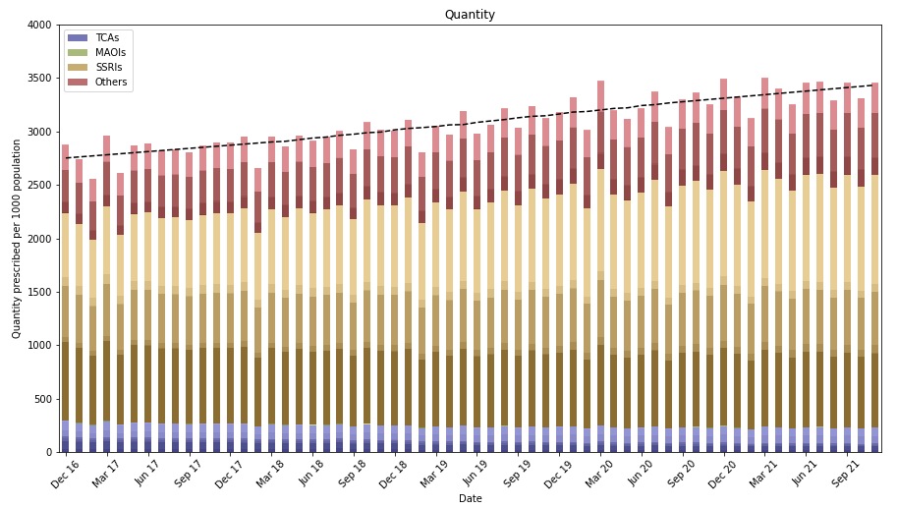
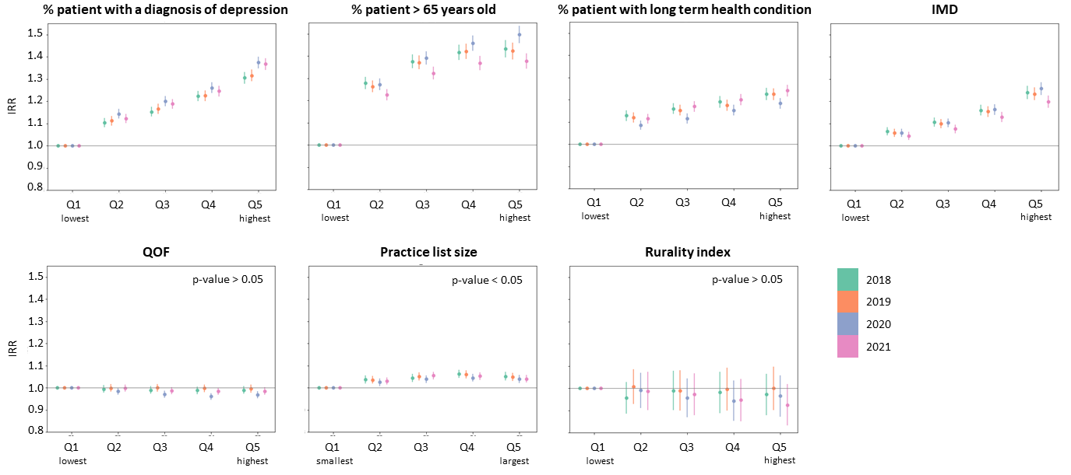

A Retrospective Database Study of Antidepressant Prescribing Patterns and Geographical Variation in England Primary Care during the COVID-19 Pandemic.
Saw K¹, Massou E²
¹School of Clinical Medicine, University of Cambridge, Cambridge, UK; ²Department of Public Health and Primary Care, University of Cambridge, Cambridge, UK;
Despite the pandemic, antidepressant prescribing patterns in primary care did not change significantly, but substantial variation was found between practices (Timelapse 1).
The total quantity of antidepressants prescribed continues to increase at a similar rate, with substantial decreases in dosulepin and trimipramine, in accordance with NICE guidelines. During the pandemic, higher prescribing rates for all classes of antidepressants are associated with deprivation, percentage of elderly patients, and percentage of patients with long-term health conditions, but not rurality, practice list size or QOF scores. This is also consistent with pre-pandemic trends and in line with other recent publications [1,2].
Timelapse 1: Quantity of antidepressants prescribed (normalised by practice list size) among CCGs from Jan 2018 to Dec 2021.
Introduction
The COVID-19 pandemic has had a significant impact on mental health and wellbeing [3]. As GPs offer more consultations over telephone compared to face-to-face, there are concerns about whether this has led to mental health issues being disproportionately managed by pharmacological treatments in primary care, as opposed to other mental health service interventions [4].
Aim
The aim of this study was to investigate the trends and practice variations in prescribing antidepressants in England during the COVID-19 pandemic.
Methods
Antidepressants were grouped into 4 classes (TCAs, MAOIs, SSRIs and others). We then analyse trends in class- and drug-specific antidepressant prescribing between December 2016 to December 2021 using publicly available data from OpenPrescribing.net and national GP profiles from Fingertips. The difference in antidepressant prescribing rates was evaluated with a multilevel mixed-effect Poisson regression model.
Results
Temporal trends
There is an increasing preference for sertraline over citalopram, as well as an overall shift away from tricyclics. Prescriptions of newer-generation antidepressants such as mirtazapine and vortioxetine, but not venlafaxine and mianserin, have also increased (Timelapse 2).
The quantity of antidepressants prescribed before and during the pandemic showed similar rates of increase (δ in Fig 1). This applies for all types of antidepressants considered in this analysis.
Associated factors
The percentage of patients older than 65 years old, percentage of patients with long-term health conditions and level of deprivation remain the most significant factors (Fig. 2).
δ = 11.606
δ = 11.411
Fig 1: Quantity of antidepressants prescribed from Dec 2016 to Nov 2021.
Fig. 2: Incidence rate ratio (IRR) and 95% CI of seven practice factors, separated into quintiles, associated with antidepressant prescribing from 2018 to 2021.
Discussion
Existing health inequalities such as deprivation, low income and poor housing are strongly associated with worse outcomes from COVID-19 [5]. Therefore, a closer analysis of the data is required to determine how the pandemic affected the ability of the NHS to meet the mental health needs of the population. This is particularly important for areas with high levels of socioeconomic deprivation where factors such as unreliable internet connection, a lack of privacy and unfamiliarity with technology means that the benefits of telephone and online consultations offered by GPs may not be equally accessible.
Timelapse 2: Percentage of antidepressants prescribed from Dec 2016 to Nov 2021.
University of Cambridge
Khai Khai Saw
Medical student • School of Clinical Medicine
E-mail: kks36@cam.ac.uk

